Slide 1

Learning Objective
I will use the CUBES problem-solving strategy to answer worded problems.
Enter quietly, please be ready with the following on your desk:
Whiteboard
Whiteboard marker
Exercise Book
Pencil, pen, ruler and red pen
Diary
Calculator
Device – charged or borrowed from Library before maths

Slide 2
Daily Review
CFU 1
What is step 1 in “working in stages”?
Use the “work in stages” strategy to calculate the following:
50 x 4 = ?
CFU 2
What is step 2 in “working in stages”?
Step 1. Break down the smaller multiplier.
Step 2. Perform the multiplications one at a time.
50 x 4
(Break down the 4)
(Multiply by the first 2)
= 50 x 2 x 2
(Multiply by the second 2)
= 100 x 2
= 100

Slide 3
Daily Review
CFU 1
What is step 1 in “working in stages”?
Use the “work in stages” strategy to calculate the following:
600 ÷ 15 = ?
CFU 2
What is step 2 in “working in stages”?
Step 1. Break down the divisor.
Step 2. Perform the divisions one at a time.
600 ÷ 15
(Break down the 15)
= 600 ÷ 3 ÷ 5
(Divide by the 3)
= 200 ÷ 5
(Divide by the 5)
= 40

Slide 4
Guided Practice
Calculate the following using the “work in stages”
Strategy:
Whiteboards
31 x 8
800 ÷ 20

Slide 5
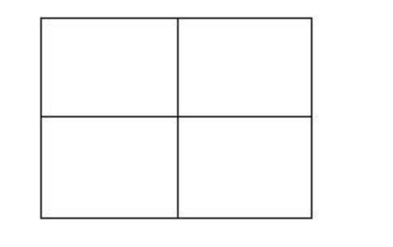
Daily Review
CFU 1
What is step 1 in using an array?
Calculate 39 x 56 using an array:
CFU 2
Step 1: split the numbers into 1s and 10s
39 x 56 = (30 + 9 ) x (50 + 6 )
What is step 2 in using an array?
CFU 3
What is step 3 in using an array?
Step 2: enter the numbers on the sides of the array
30 9
CFU 4
What is step 4 in using an array?
50
6
1500
450
180
54
1500
450
180
54
+
Step 3: multiply each horizontal by each vertical and enter in the array
2184
Step 4: add up each number inside the array

Slide 6
Daily Review
Whiteboards
Calculate 19 x 33 using an array:

Slide 7
Daily Review
CFU
UNDERLINE, DO and DROP.
What does BIMDAS stand for?
BIMDAS
1. Brackets first.
2. Indices next.
3. Multiplication and Division in order from left to right.
4. Addition and Subtraction in order from left to right.
CFU
What order do you do multiplication and division in?
CFU
What is the strategy for setting out your work?
Whiteboards
5 x 3 - 2
Is there any:
1. Brackets?
4 + 4 x 4
20 – 32 ÷ 8
No
=
15
- 2
2. Indices?
No
=
13
3. Multiplication or Division?
Yes! Underline, do & drop!
4. Addition or Subtraction?
Yes! Underline, do & drop!

Slide 8
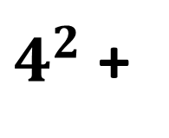
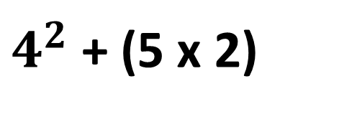
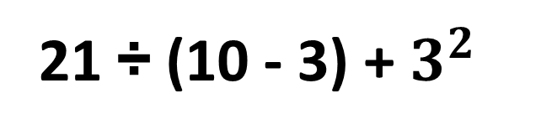
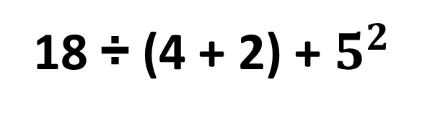
Daily Review
CFU
UNDERLINE, DO and DROP.
What does BIMDAS stand for?
BIMDAS
1. Brackets first.
2. Indices next.
3. Multiplication and Division in order from left to right.
4. Addition and Subtraction in order from left to right.
CFU
What is the strategy for setting out your work?
Whiteboards
$4^{2}$ + (5 x 2)
21 ÷ (10 - 3) + $3^{2}$
18 ÷ (4 + 2) + $5^{2}$
=
$4^{2}$ +
10
=
16
+ 10
=
26

Slide 9
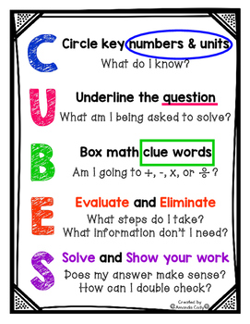
Learning Objective
CFU
What will we learn today?
I will use the CUBES problem-solving strategy to answer worded problems.
CFU
How will you know that you are successful?
Success Criteria
At the end of the lesson, I will be able to:
Recite the CUBES strategy.
Use the CUBES strategy to select an appropriate solving method.
Solve worded whole number problems.

Slide 10

Activate Prior Knowledge
2:00
1:59
1:58
1:57
1:56
1:55
1:54
1:53
1:52
1:51
1:50
1:49
1:48
1:47
1:46
1:45
1:44
1:43
1:42
1:41
1:40
1:39
1:38
1:37
1:36
1:35
1:34
1:33
1:32
1:31
1:30
1:29
1:28
1:27
1:26
1:25
1:24
1:23
1:22
1:21
1:20
1:19
1:18
1:17
1:16
1:15
1:14
1:13
1:12
1:11
1:10
1:09
1:08
1:07
1:06
1:05
1:04
1:03
1:02
1:01
1:00
0:59
0:58
0:57
0:56
0:55
0:54
0:53
0:52
0:51
0:50
0:49
0:48
0:47
0:46
0:45
0:44
0:43
0:42
0:41
0:40
0:39
0:38
0:37
0:36
0:35
0:34
0:33
0:32
0:31
0:30
0:29
0:28
0:27
0:26
0:25
0:24
0:23
0:22
0:21
0:20
0:19
0:18
0:17
0:16
0:15
0:14
0:13
0:12
0:11
0:10
0:09
0:08
0:07
0:06
0:05
0:04
0:03
0:02
0:01
End
1:00
+ | - | x | ÷
Add
Difference
Divide
Lots of
Sum
Altogether
Minus
Quotient
Subtract
Multiply
Share
Product
Total
Goes into
Less than
Times
Add
Sum
Total
Altogether
Subtract
Minus
Less than
Difference
Multiply
Times
Lots of
Product
Divide
Share
Goes into
Quotient

Slide 11

Relevance
When have you ever seen a nicely set out maths problems like this in real life?
2000 – (36 + 49 + 98)
You are more likely to encounter a problem like this:
You have just been given your $2000 pay check. You need to buy $36 worth of clothes, $49 worth of textbooks and spend $98 on groceries. How much money will you have left over to put into savings?

Slide 12
Concept Development
CFU
What is the purpose of the CUBES strategy?
The CUBES problem-solving strategy helps to break down a complicated worded problem and choose an appropriate method to solve it.
CFU
What does CUBES stand for?
C
ircle key numbers and units.
U
nderline the question.
B
ox any important words.
E
liminate useless words and Evaluate which method to use.
S
olve the problem and Show your working.

Slide 13
Skill Development
Harvey ‘Scoop’ Roberts, a journalist with the Monthly Farm News, can type 60 words per minute. How long does it take him to type an article of 1800 words?
How many times does 60 go into 1800?
I’m going to use the ‘work in stages’ method.
60 x ? = 1800
1800 ÷ 60 = ?
= 1800 ÷ 10 ÷ 6
It takes Harvey 30 minutes.
= 180 ÷ 6
= 30

Slide 14
Skill Development
Mick is a baker in a supermarket. He makes hot cross buns and packs them in bags of 6. He stacks 4 shelves with 8 bags on each shelf. At the end of the day, Mike has 3 bags of buns left. How many hot cross buns did he sell?
There are 6 lots of 8 on each shelf.
There are 4 shelves in total.
How many are subtracted if
there are 3 lots of 6 left over?

Slide 15
Skill Development
There are 6 lots of 8 on each shelf. There are 4 shelves in total.
How many are subtracted if
there are 3 lots of 6 left over?
6 x 8
x 4
- ?
= 3 x 6
I’m going to use BIMDAS and an array.
6 x 8 x 4 – ? = 3 x 6
6 x 8 x 4 – 3 x 6 = ?
= 48 x 4 – 3 x 6
48 x 4
160
+ 32
= 192 – 3 x 6
40
8
= 192 – 18
4
160
32
192
= 174

Slide 16
Skill Development
Mick is a baker in a supermarket. He makes hot cross buns and packs them in bags of 6. He stacks 4 shelves with 8 bags on each shelf. At the end of the day, Mike has 3 bags of buns left. How many hot cross buns did he sell?
174
Mike sold 174 hot crossed buns.

Slide 17
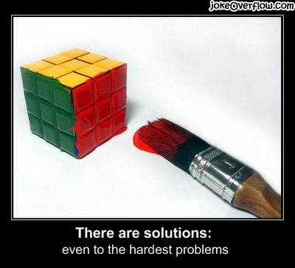
Skill Closure
What have we learnt today?
Lesson Objectives:
I will use the CUBES problem-solving strategy to answer worded problems.
What does CUBES stand for?
Circle
Underline
Box
Eliminate and Evaluate
Solve and Show working

Slide 18


Independent Practice
Mathematics Page Layout
Open your textbooks to:
Chapter 1.6
Questions: 1 – 6, 8, 10

